Slide 1
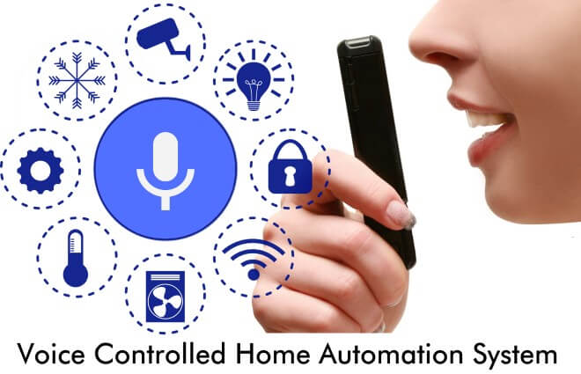
HOME AUTOMATION (Voice Controlled)
Submitted By: - Ayush Sharma
16BCS1550

Slide 2
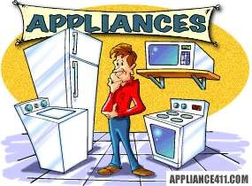
What is Home Automation or HA?
Home Automation is a wireless home appliance control system accessed by a remote device such as mobile phone(Android or IOs) to allow a home owner to control, monitor and coordinate home appliances, without changing the home infrastructure.

Slide 3
Why Home Automation ?
Saves time
Save money (Long run)
Self Maintenance
Security
Makes life easy

Slide 4
System Design
 HA is a system which is controlled by a remote system such as a cell phone like , Android or IOs Phone.
 It is build around a microcontroller ,with adjoining relays for interfacing with AC devices.
 There will be sensors for the system to operate automatically according to
weather conditions.
 In case of emergency such as fire, the user or an organization such as Fire Department should be notified.
 Also, HA should have a database of information about the users and
appliances.

Slide 5
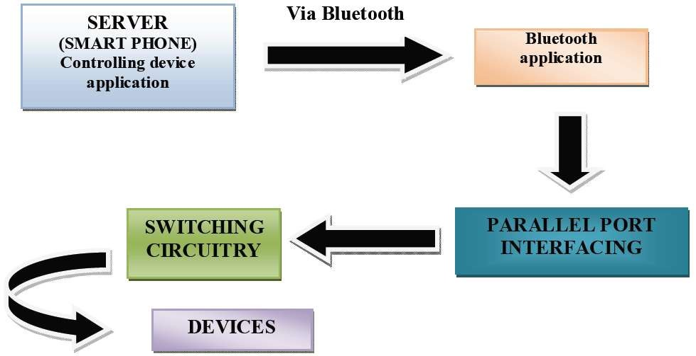
SYSTEM DATA FLOW

Slide 6


Software Description
ANDROID
 Android has an active community of developers and enthusiasts who use the Android Open Source
Project (AOSP) source code to develop and distribute their own modified versions of the operating
system.
ARDUINO
 Arduino is an open source physical computing platform for creating interactive objects that stand alone or collaborate with software on your computer. Arduino was designed for artists, designers, and others who want to incorporate physical computing into their designs

Slide 7
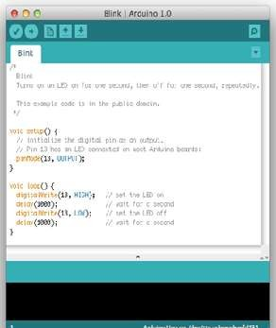
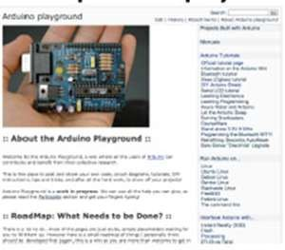
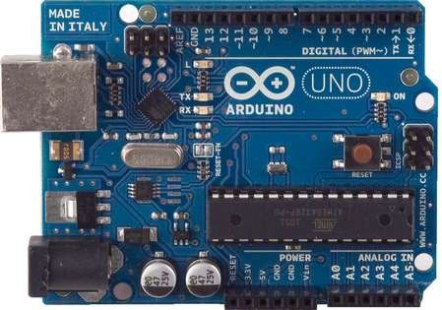
The word “Arduino” can mean three things
A piece of hardware
A programming environment
A community or philosophy

Slide 8
Android
 Android is an mobile operating system currently developed by Google, based on Linux Kernel
 Android is primarily a Google effort, in collaboration with the Open Handset Alliance.
 Android has an active community of developers and enthusiasts who use the Android Open Source Project (AOSP) source code to develop and distribute their own modified versions of the operating system.

Slide 9
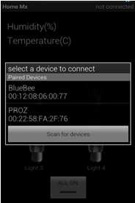
Bluetooth Application
 Blue Term 1.0 is an open source Android Application which can be used to send the Bluetooth commands to Bluetooth Module via serial com port (Rx-TX).
 Android uses Bionic in place of a standard C library, originally developed by Google specifically for Android, as a derivation of the BSD's standard C library code.
 The main benefits of using Bionic instead of the GNU C
Library are its different licensing model, smaller runtime footprint,
and optimization for low-frequency CPUs.
 It is under GPL license and provided on Github.

Slide 10
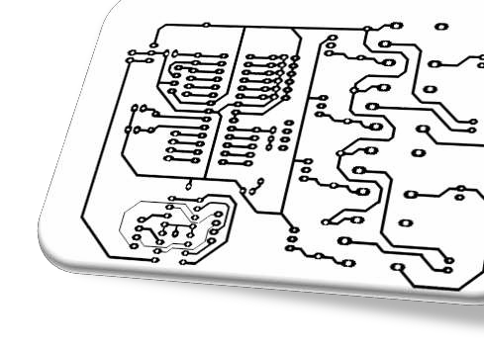
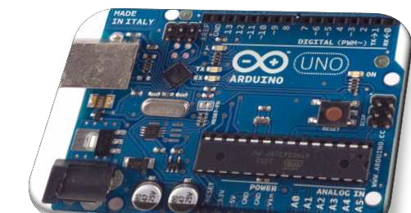
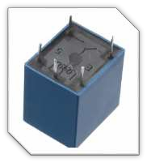
Hardware Description
Home automation contains a controller, various sensors, relays, motors and further A.C. Appliances which are needed to be controlled.
 It has ARDUINO controller which provides the necessary signals for the output devices connected.
 It has a Bluetooth module which is responsible for communicating to the mobile device or smart phone.
 Relays are connected in the circuit to isolate the AC appliances with the
microcontroller.
 Motor driver ICs for driving the dc motors.

Slide 11
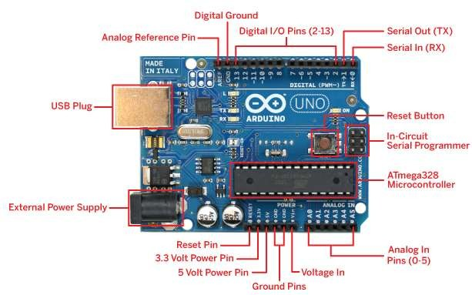
What is Arduino?
Arduino is an open-source development environment or open-source hardware
platform based on an Atmel AVR 8-bit microcontroller and a C++ based IDE.

Slide 12
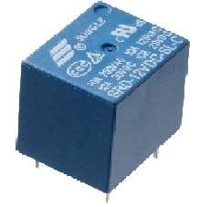
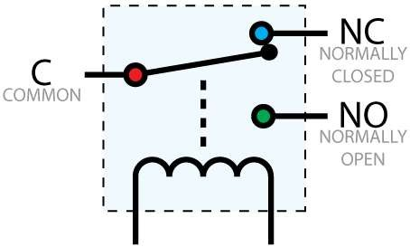
RELAY
 A relay is an electrically operated
switch.
 Many relays use an electromagnet to mechanically operate a switch, but other operating principles are also used, such as solid-state relays.
 Relays are used where it is necessary to control a circuit by a low-power signal (with complete electrical isolation between control and controlled circuits), or where several circuits must be controlled by one signal.

Slide 13
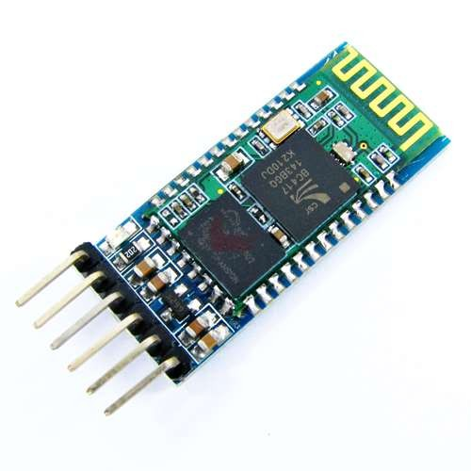
Bluetooth Module
The Bluetooth Trans receiver HC-05 Breakout is the latest Bluetooth wireless serial cable! This version of the popular Bluetooth uses the HC- 05/HC-06 module. These modems work as a serial (RX/TX) pipe. Any serial stream from 9600 to 115200bps can be passed seamlessly from your computer to your target.
The remote unit can be powered from 3.3V up to 6V for easy battery attachment
It Support for 802.11 protocol.

Slide 14
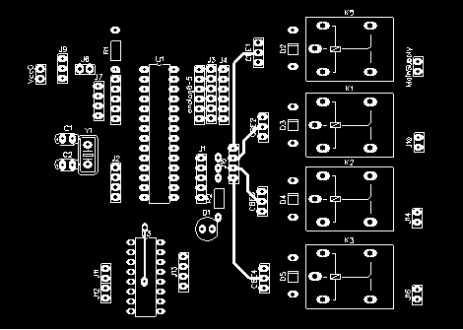
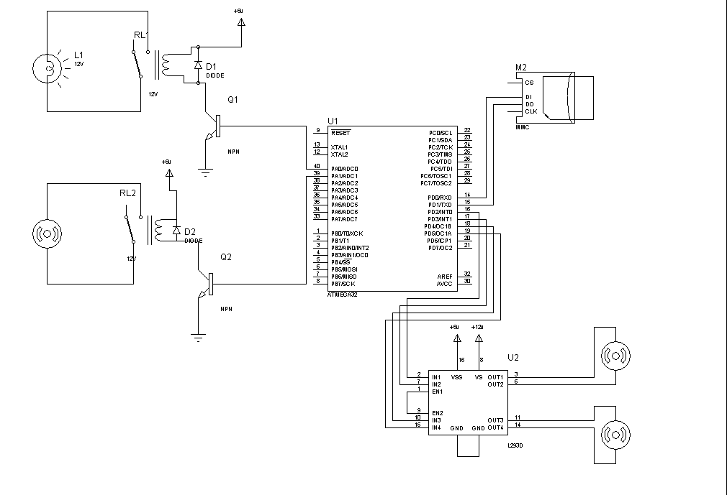
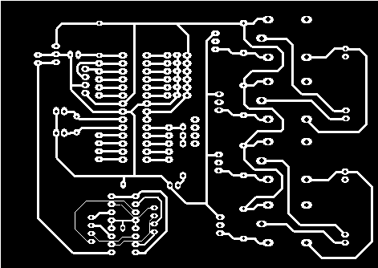
Schematic Diagram & PCB Layoutof Home
Automation

Slide 15
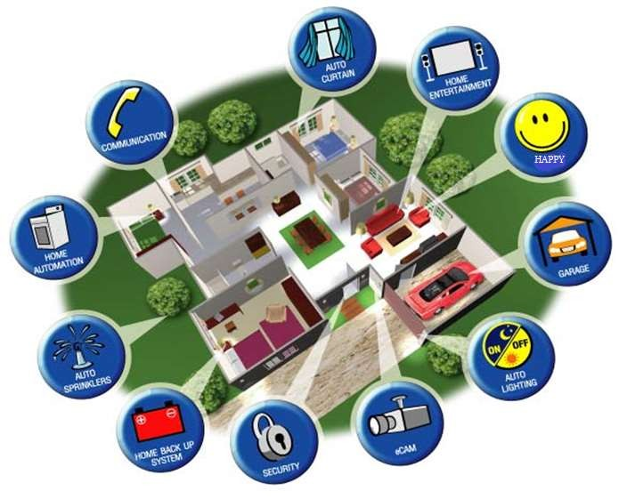
Where is Home Automation going?

Slide 16
Conclusion
Strengths:
Multiple socket control
Possible expansion of new sockets
Cost effective
Weakness:
Susceptible to Noise
Susceptible to long distance in large house

Slide 17
Thank you
Happy controlling your home

